Slide 1
Data After Dark
presents
Animal Welfare in the Modern World
Michelle Butts-Spence and Kris Dillon

Slide 2
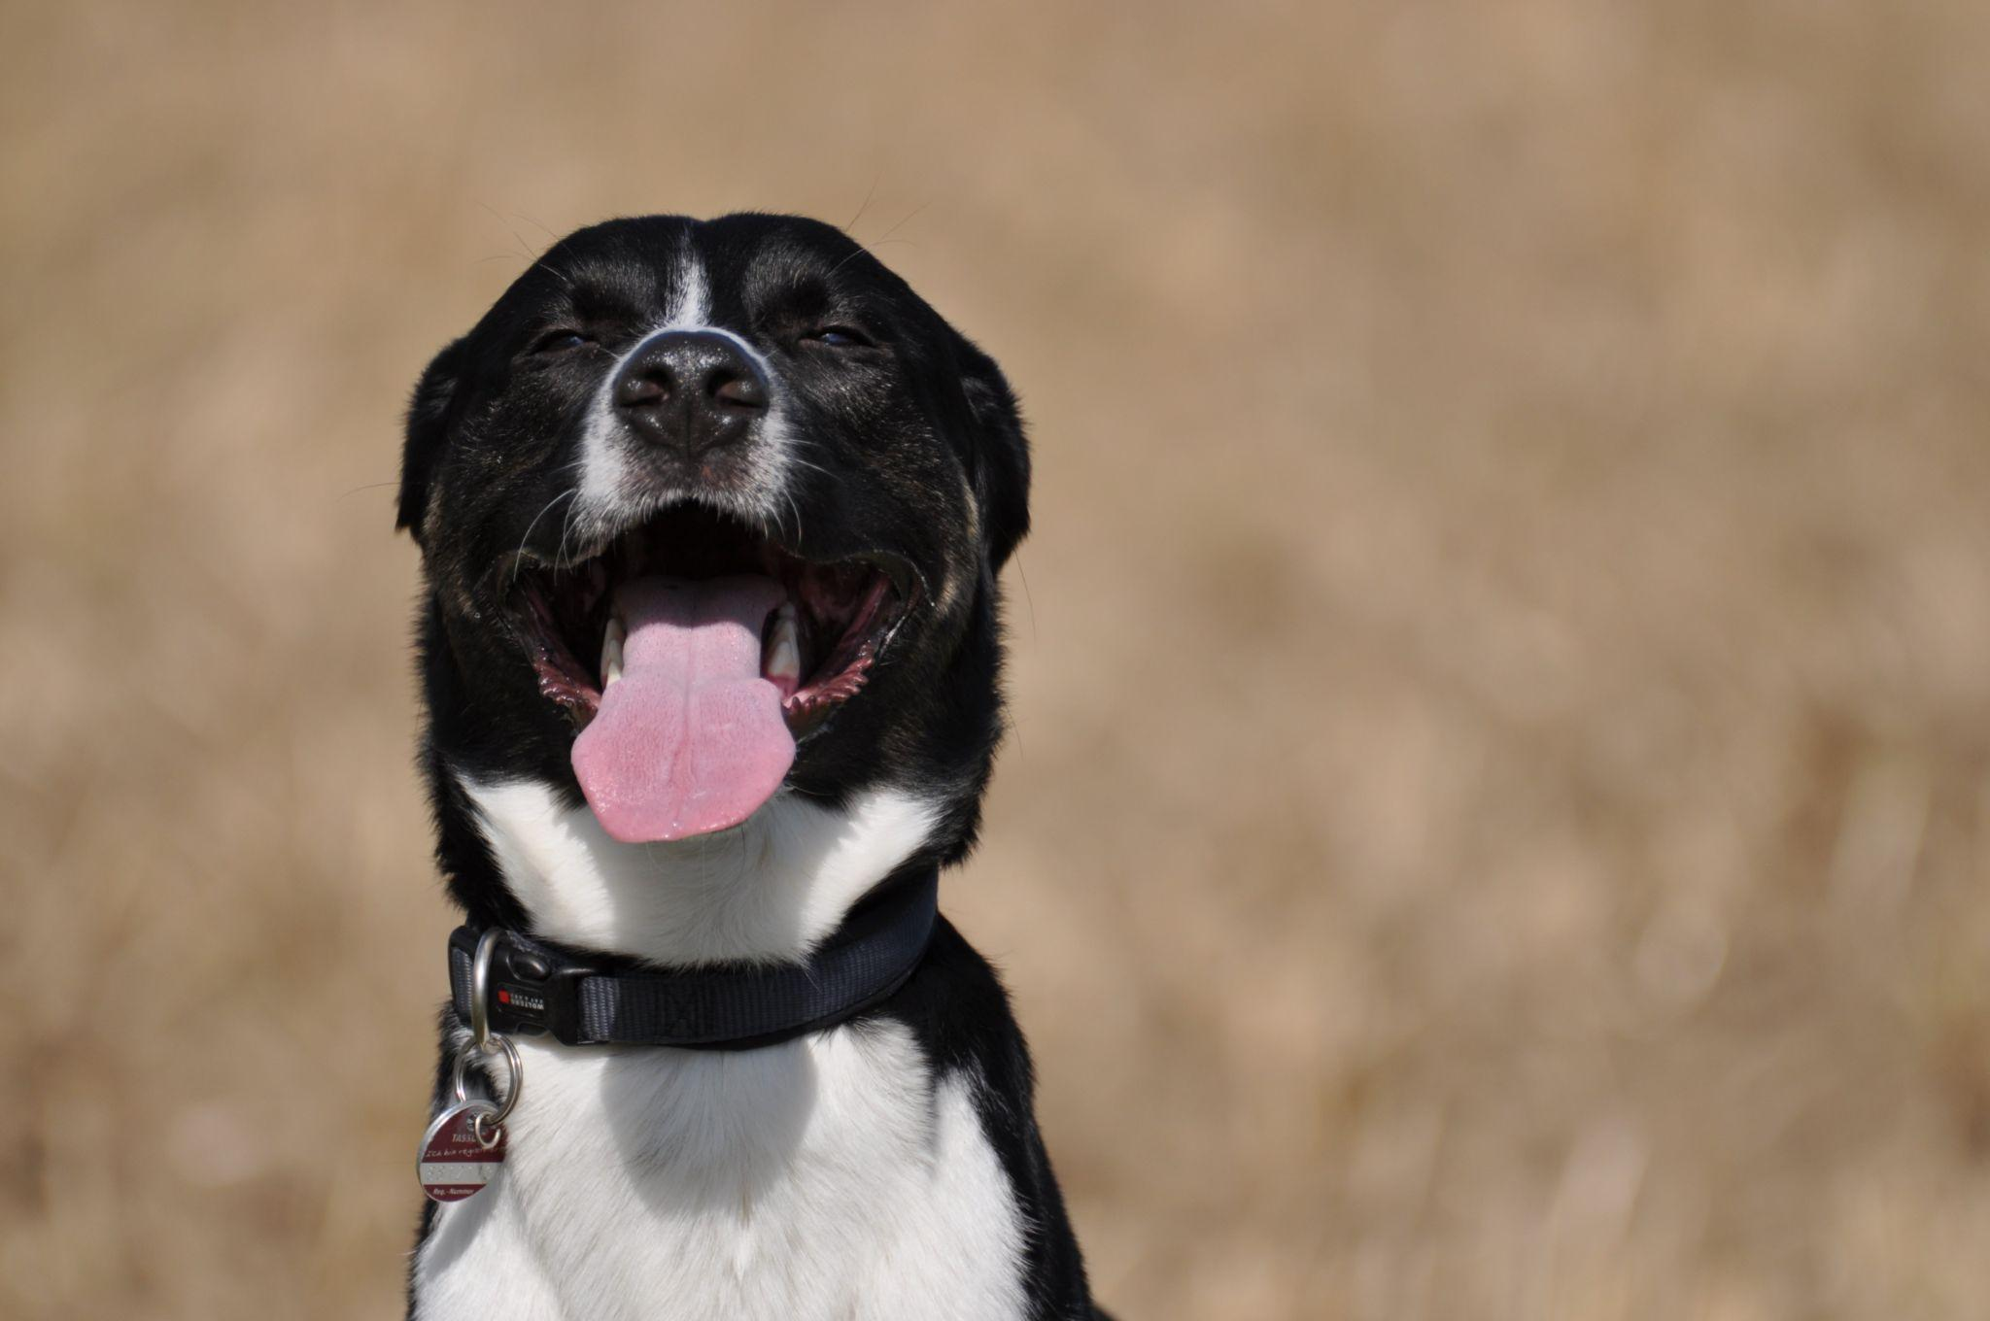

Meet the Team:
Michelle Butts-Spence
BS in Special Education from Wayne State University
MA in Curriculum & Technology from the University of Phoenix
Skilled in Microsoft Office, HTML, Python, R, RStudio, VisualStudio, Jupyter Notebook, Tableau, and Excel
20 + years of experience teaching at all levels from preschool to 26 years of age, all subjects at elementary level, teacher consultant for special education and technology.
Taught technology skills to staff, administration, teachers and students for 20+ years.
Animal advocate, rescuer, and foster for 20+ years, specializing in medical foster.
Currently working in rescue and a career pivot into Data Science

Slide 3


Meet the Team:
Kris Dillon
Bachelor of Fine Arts in Theatre Management
12 years in office management and business administration
Skilled with Microsoft Office Suite, Python, R, RStudio, Visual Studio Code, Jupyter Notebook, and Tableau
Legal, Accounting, Educational, and Medical databases
Always had interest in coding
Fascinated by how things work
Rescued FeLV+ cats and is considered a cat whisperer by friends
Currently employed as a Medical Office Specialist

Slide 4
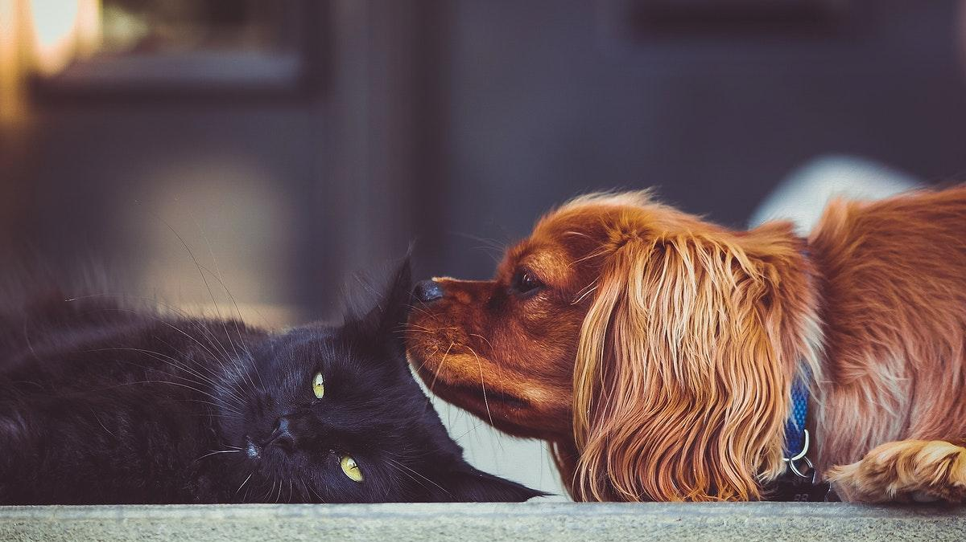
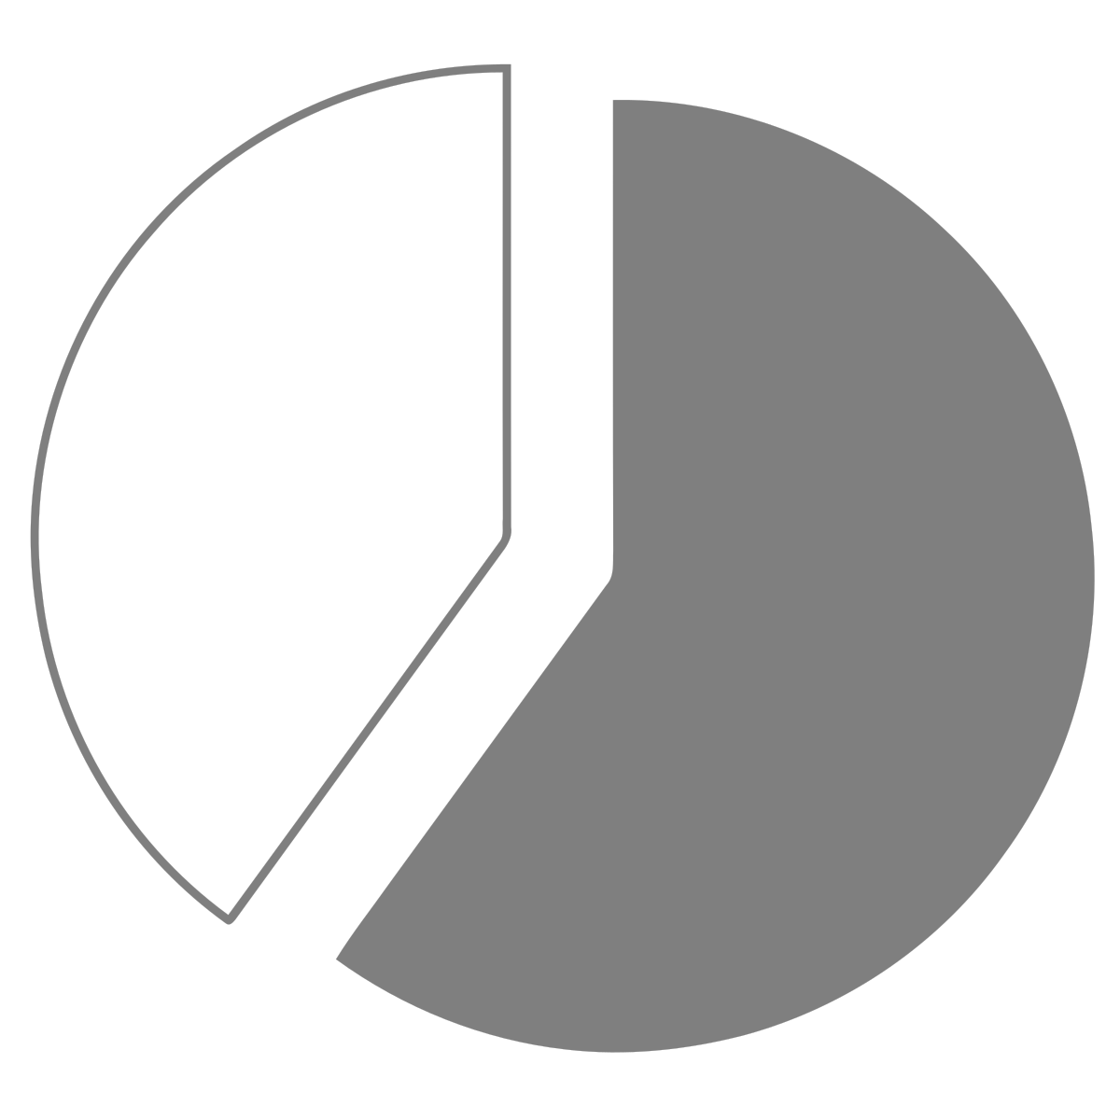
Background
In 2003 it was estimated that about 60% of US households owned a pet
, but only 10-20% of cats and dogs were adopted from shelters or rescues.
60-70% of shelter animals were euthanized each year.
Many believed in the beginning of Covid lockdown that adoption rates increased and euthanasia rates decreased.

Slide 5

Background
The main reason for euthanizing perfectly healthy and well-behaved animals in shelters is due to a lack of space and overcrowding.
Rescue groups provide some relief by pulling animals from shelters, but it’s not enough.
Let’s looked at the numbers.

Slide 6

Methods: Finding the Data
Searched Google, Kaggle, and individual state government websites for animal shelter data
Quickly found no standard criteria for shelter reporting at a national or individual state level
Shelter Animals Count is an organization that collects and reports shelter data collected from participating shelters and rescues in the US.
Georgia state data was available starting mid-2020 (law enacted 7/2020)
No Texas state data was found, but major cities had some form of reporting with varying degrees of information

Slide 7

Methods: Data Wrangling
The programs utilized to get the raw data into a usable format were:
Microsoft Excel
RStudio
Python
Jupyter Notebook
The recoding of data from categorical data to continuous was performed in order to run a variety of analyses.

Slide 8

Methods: Important Variables
The most common variables found across all datasets were:
Year
Animal Type (feline or canine)
Shelter Outcome (euthanized or live)
The reporting criteria for shelter animals varies widely by state in the US.
Many states do not have statewide data and refer to the Shelter Animal Counts data, which is voluntarily reported by members of the organization.

Slide 9

Results: Evaluation Questions
Did the number of adoptions of shelter animals increase during the Covid pandemic shutdown?
Did the number of euthanasias of shelter animals decrease during the shutdown?
Do euthanasia rates differ between state data and the national dataset?
Do Trap Neuter Release programs decrease euthanasia rates?

Slide 10

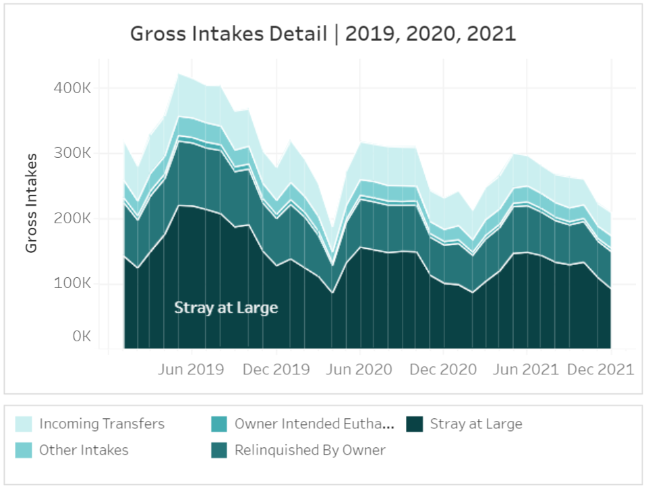
Results: National Intakes of Cats and Dogs
National intakes regularly drop following summer and increase in the spring, however in 2020, the number continued dropping into May.
Overall, intakes have declined steadily since fall of 2019.
At the start of the pandemic shelters shut down and activity dropped significantly.

Slide 11

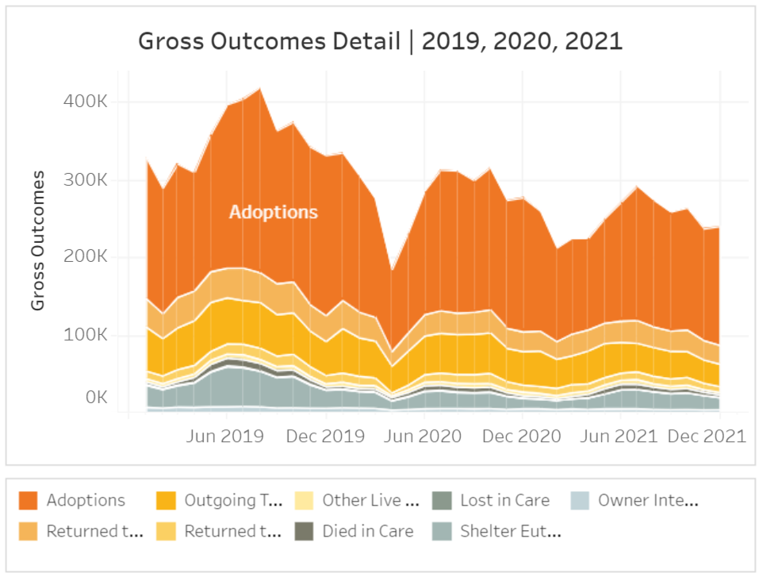
Results: National Outcomes of Cats and Dogs
National trends have shown a decrease in the number of animals in shelters, but a significant drop during the first months of the pandemic.
Naturally, adoption rates follow the same pattern as intakes.
Euthanasia rates decreased steadily as the number of intakes decreased.

Slide 12
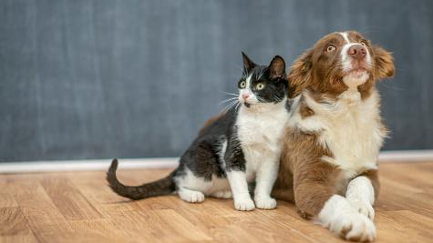
Results: National Summary
National Cat Euthanasia Rate for 2019: 14.4%
National Cat Euthanasia Rate for 2020: 9.2%
National Cat Euthanasia Rate for 2021: 8.9%
National Dog Euthanasia Rate for 2019: 10.2%
National Dog Euthanasia Rate for 2020: 8.2%
National Dog Euthanasia Rate for 2021: 8.3%

Slide 13

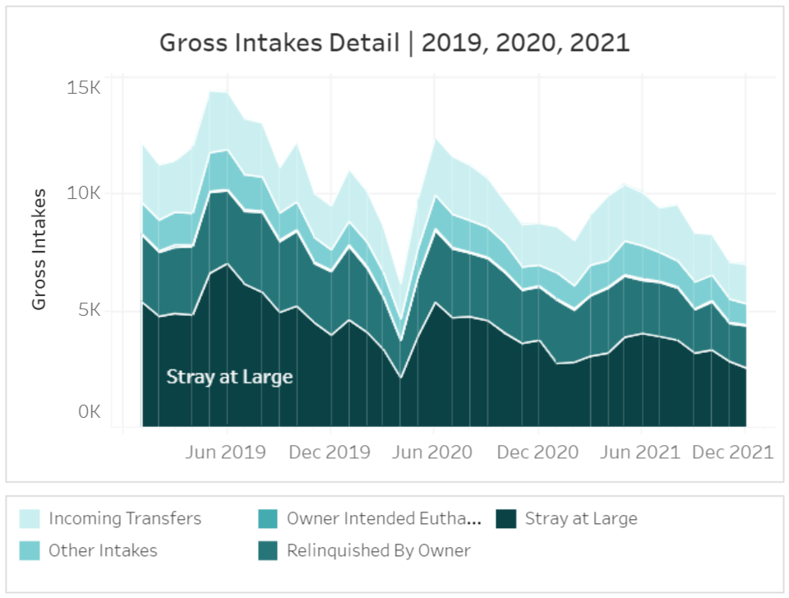
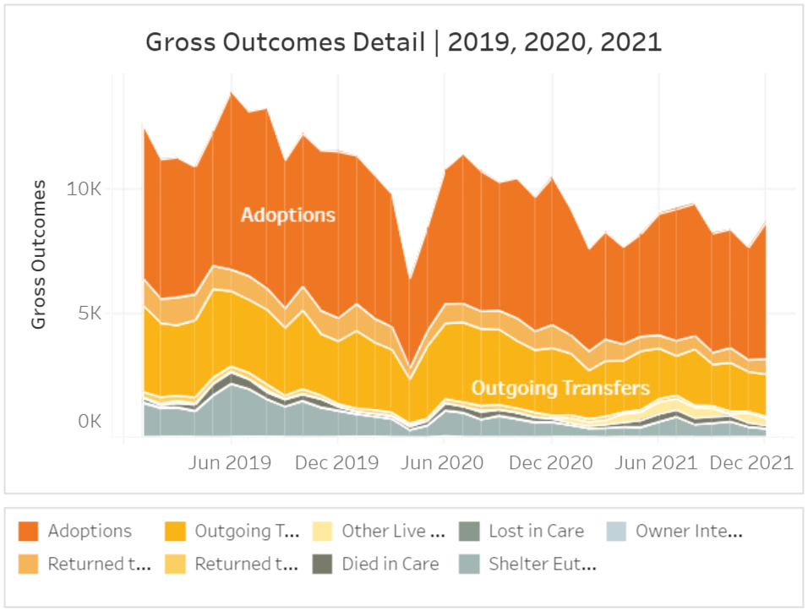
Results: Georgia Euthanasia Rates
Results: Georgia Intake & Euthanasia Rates
National adoptions accounted for the majority of outcomes, but Georgia has a large number of transfers thanks to rescue groups. Adoptions however declined after the start of Covid.
But as you can see, the number of intakes declined more than the outcomes, with euthanasia rates steadily declining as well.

Slide 14
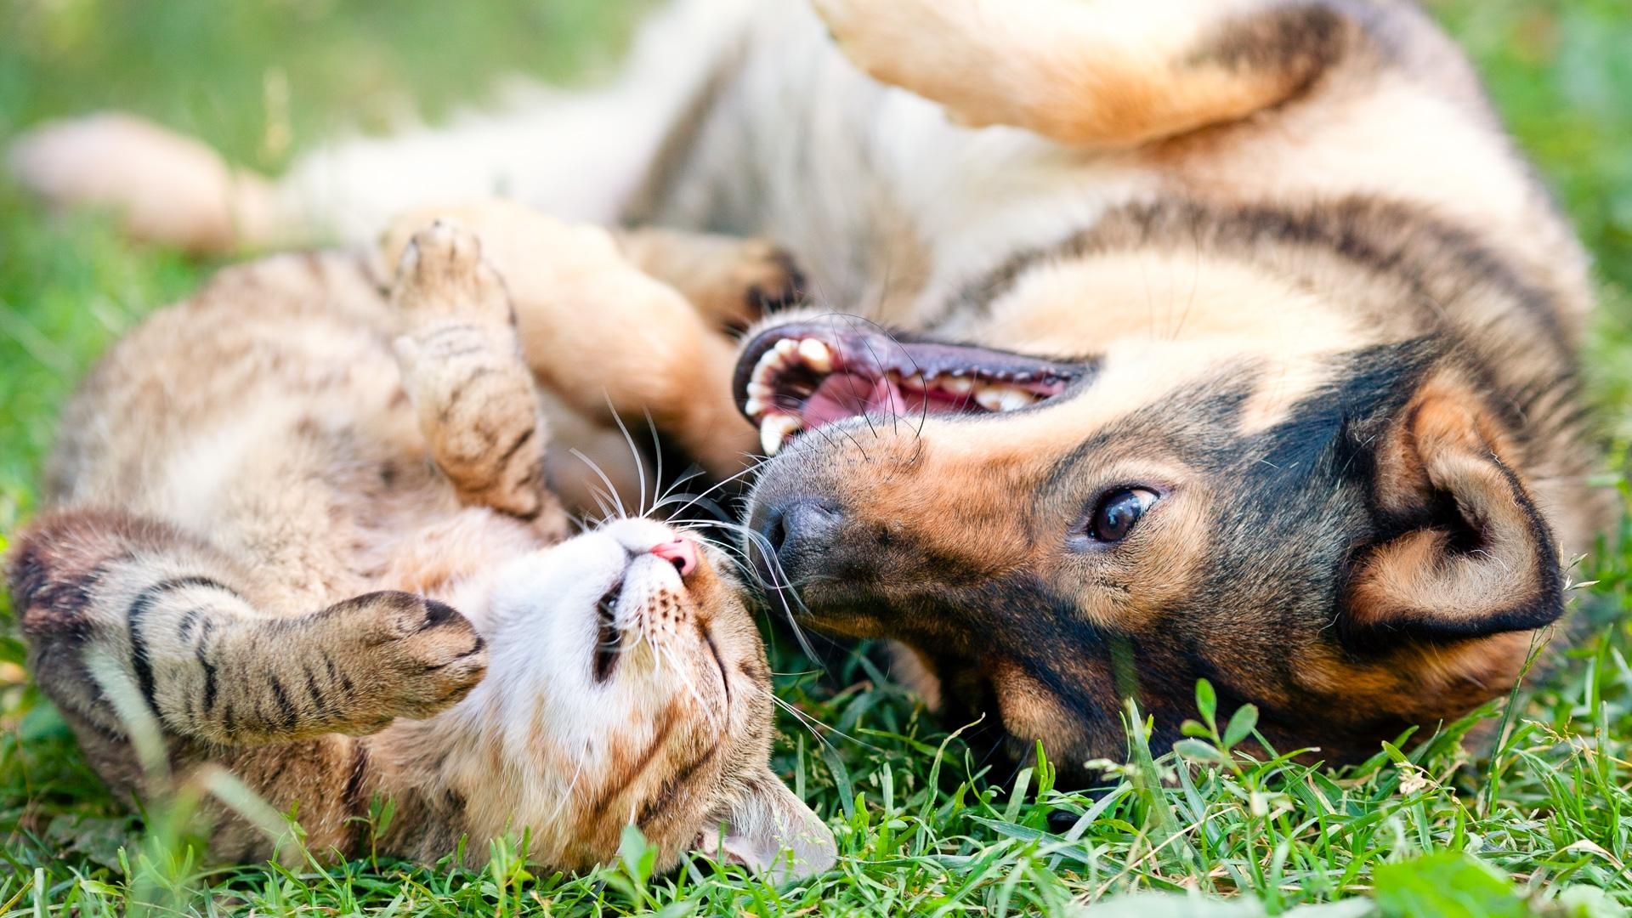
Results: Georgia Euthanasia Summary
Shelter Animals Count data:
Georgia Cat Euthanasia Rate for 2019: 9%
Georgia Cat Euthanasia Rates for 2020: 7%
Georgia Cat Euthanasia Rates for 2021: 7%
Georgia Dog Euthanasia Rate for 2019: 7%
Georgia Dog Euthanasia Rates for 2020: 4%
Georgia Dog Euthanasia Rates for 2021: 5%
Georgia Department of Agriculture Results for 2021:
Cat Intake = 19374
Dog Intake = 13466
Cat Euthanasia = 2602 (or 13%)
Dog Euthanasia = 1759 (or 13%)
The rates are slightly higher for cats than dogs, but the numbers are substantially greater in the Georgia Dept. of Ag. data than the SAC data suggests.

Slide 15
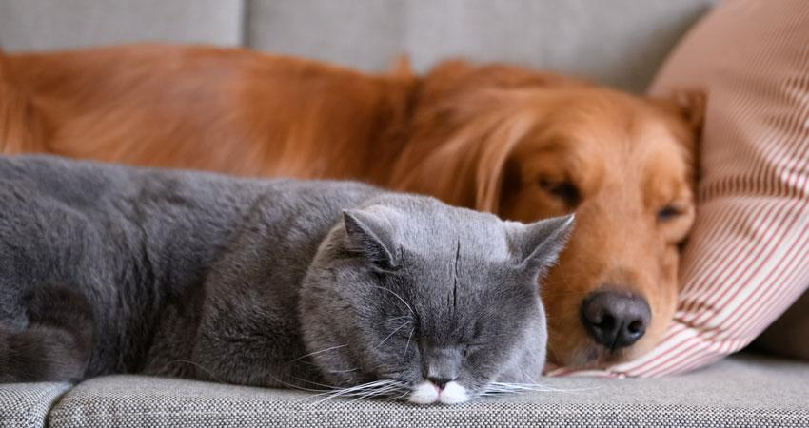
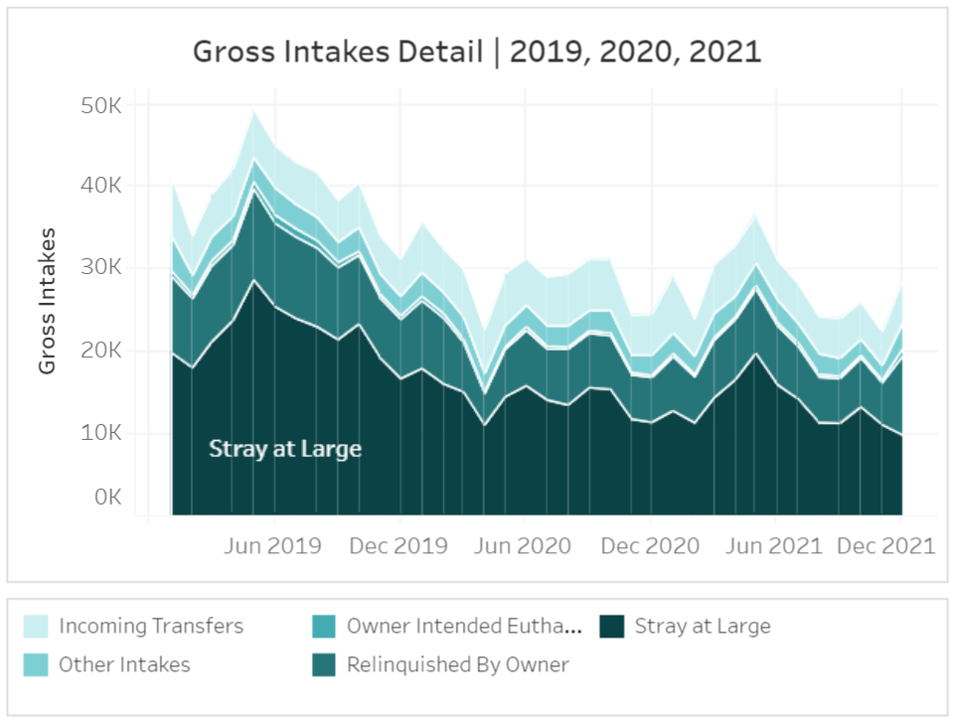
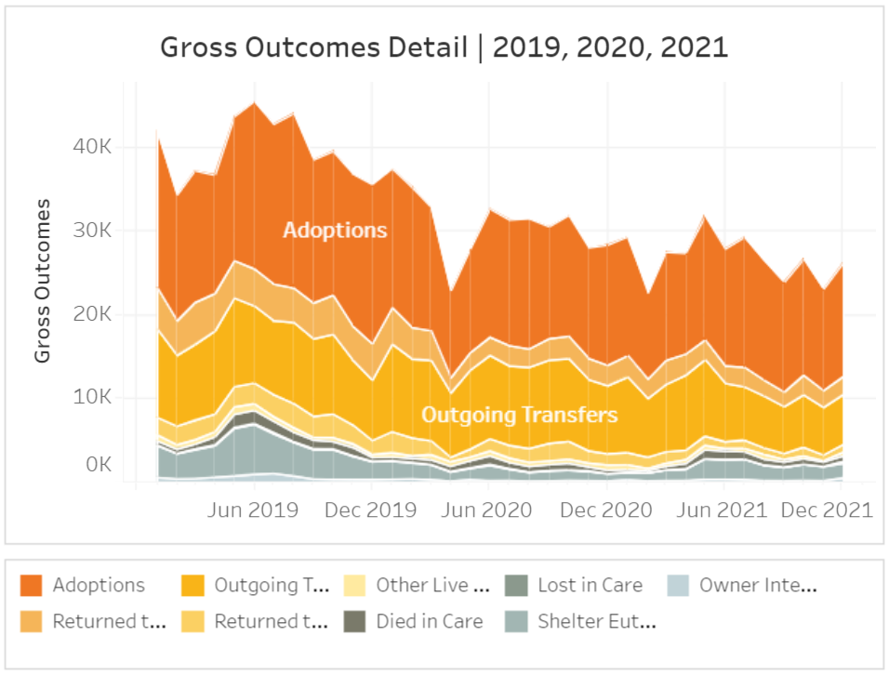
Results: Texas Euthanasia Rates
Results: Texas Intake & Euthanasia Rates
Similar to Georgia, Texas has a large amount of transfers thanks to rescue groups pulling from shelters.
You can see that intakes also declined and euthanasia decreased significantly until summer of 2021, around the same time as a large influx of intakes came in.

Slide 16

Results: Texas Summary
Texas Cat Euthanasia Rate for 2019: 12.9%
Texas Cat Euthanasia Rate for 2020: 6.1%
Texas Cat Euthanasia Rate for 2021: 6.6%
Texas Dog Euthanasia Rate for 2019: 9.3%
Texas Dog Euthanasia Rate for 2020: 4.8%
Texas Dog Euthanasia Rate for 2021: 6.4%

Slide 17
Results: Trap Neuter Release Programs
There was not enough data on TNR programs to analyze.
Recommendations for standardized reporting:
Year
Age
Species (Feline or Canine)
Intake reason (stray, owner surrender, etc.)
Outcome type (adoption, rescue, euthanized, etc.)
Intake status (intact/altered)
Outgoing status (intact/altered)

Slide 18
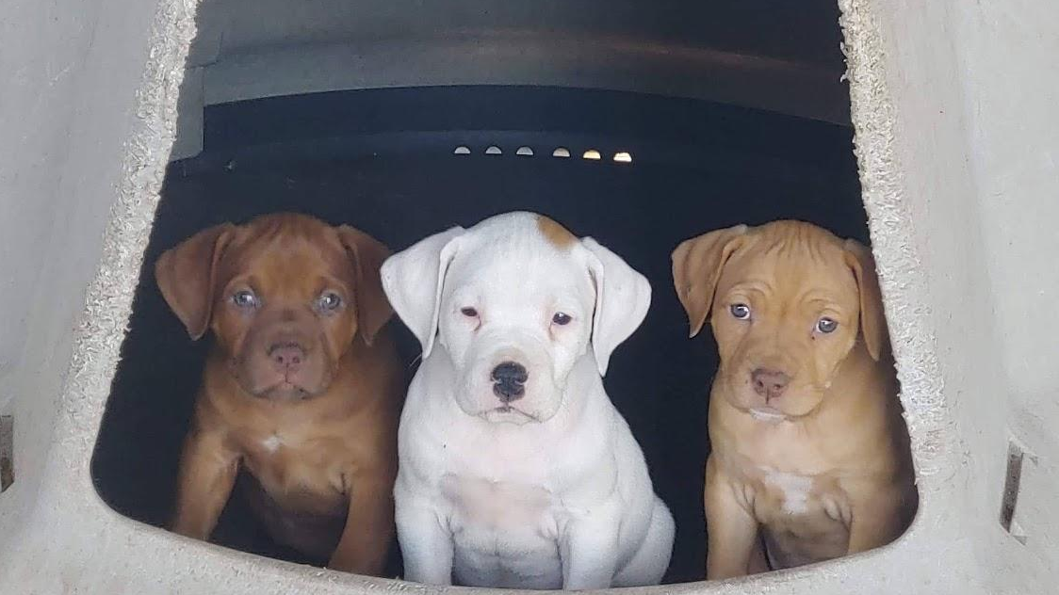
Summary
Through our research and data analysis, we discovered:
Adoption rates did not increase during Covid
Euthanasia rates did decrease during Covid, mirrored by a decrease in intakes
The national data we found through Shelter Animals Count reports lower numbers than individual state data where there is mandatory reporting.
There is far too little data on Trap Neuter Release programs

Slide 19

Conclusion
The data shows as the number of animals increases in shelters the number of euthanasia also increases.
The Southeastern United States has a greater euthanasia rate than anywhere else in the country.
The need for a national accounting system for animal welfare can and should be established.
We created recommendations to share with interested parties to standardize how cities, counties, and states can record animal intakes and outcomes.

Slide 20


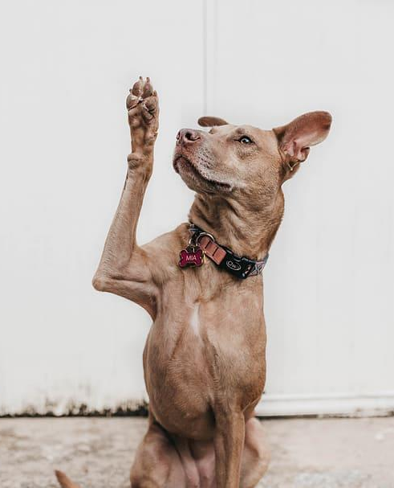
Questions?

Slide 21

Thank you!
The information contained herein was derived from data supplied by Shelter Animals Count. Shelter Animals Count specifically disclaims all responsibility for any analysis, interpretations, conclusions and opinions contained in the information presented.

